Slide 1



ANALYSIS OF
CONSUMER PREFERENCES AND TRENDS FOR FOUNDATION AT SEPHORA
ASHLEY DOAN
SELENE NGUYEN

Slide 2



DATA RETRIVAL
01.
02.
03.
INSPECT THE NETWORK ACTIVITY ON SEPHORA’S FOUNDATION PRODUCT PAGES AND IDENTIFY THE JSON FILE THAT CONTAINS PRODUCT INFORMATION.
RETRIEVE DATA FROM ALL 5 PAGES OF FOUNDATION PRODUCTS USING FOR LOOP
CONVERT THE DATA INTO A DATAFRAME WITH 11 VARIABLES AND 262 OBSERVATIONS.

Slide 3
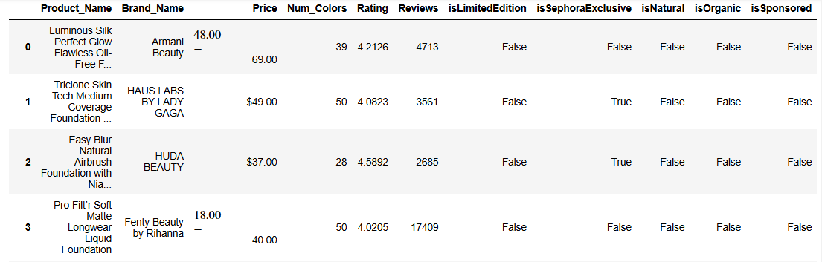


Next Slide

Slide 4

DATA CLEANING
FILTER BY PRODUCT TYPE
CONVERT BOOLEAN VARIABLES
HANDLE PRICE RANGES
CONVERT DATA TYPES
For products with price ranges, select the higher price value as the representative price for full-size products.
Change Price, Num_Colors, Rating, and Reviews to numerical data types to facilitate analysis.
Retain only products with "foundation" in the name; exclude products containing terms like "brush," "sample," or "pump."
Change boolean values (true, false) in columns such as isLimitedEdition, isSephoraExclusive, isNatural, isOrganic, and isSponsored to binary format (1 for true, 0 for false).

Slide 5
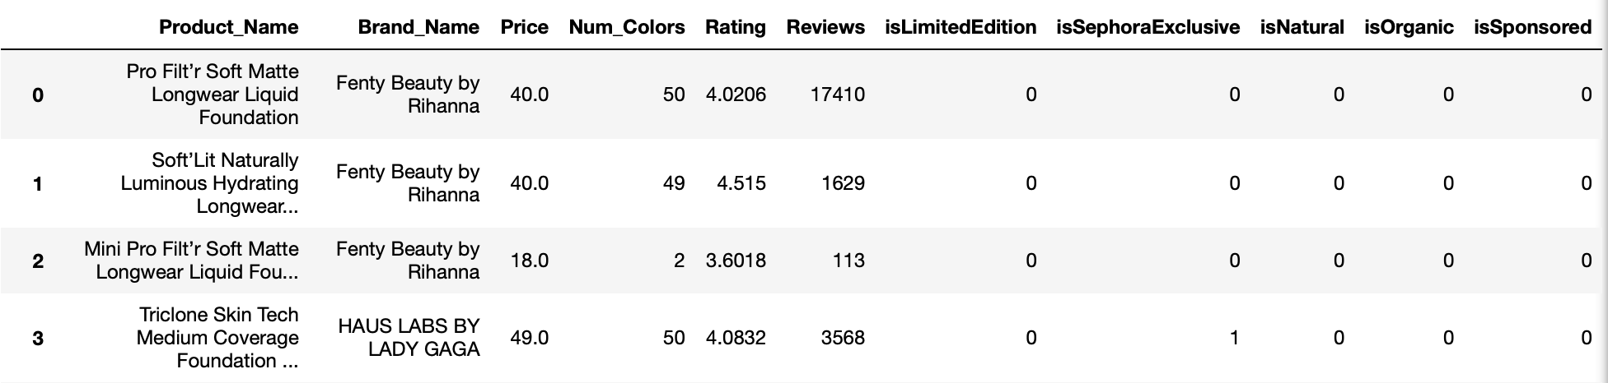

Slide 6
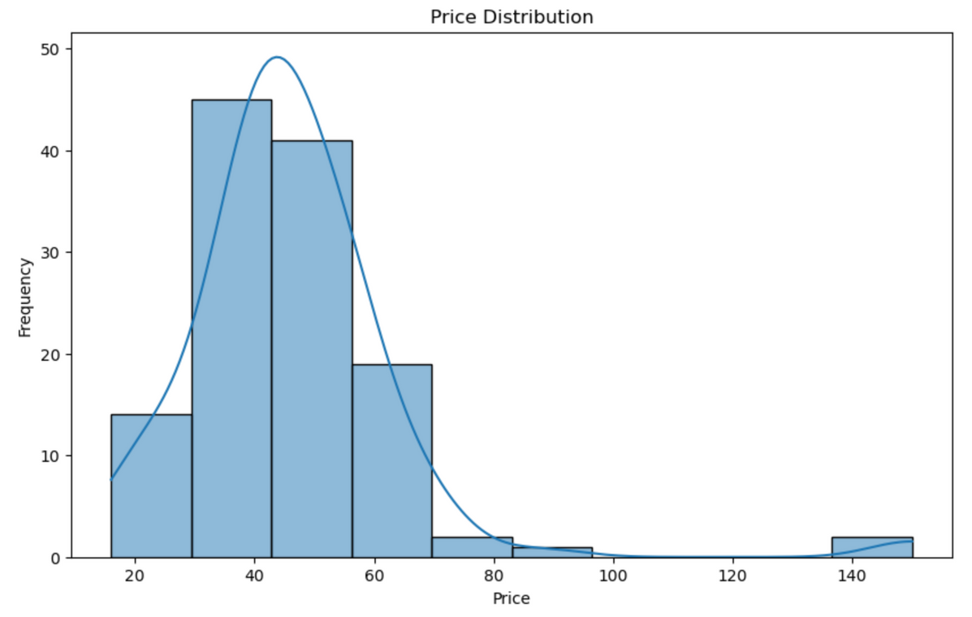
EXPLORATORY DATA ANALYSIS

Slide 7
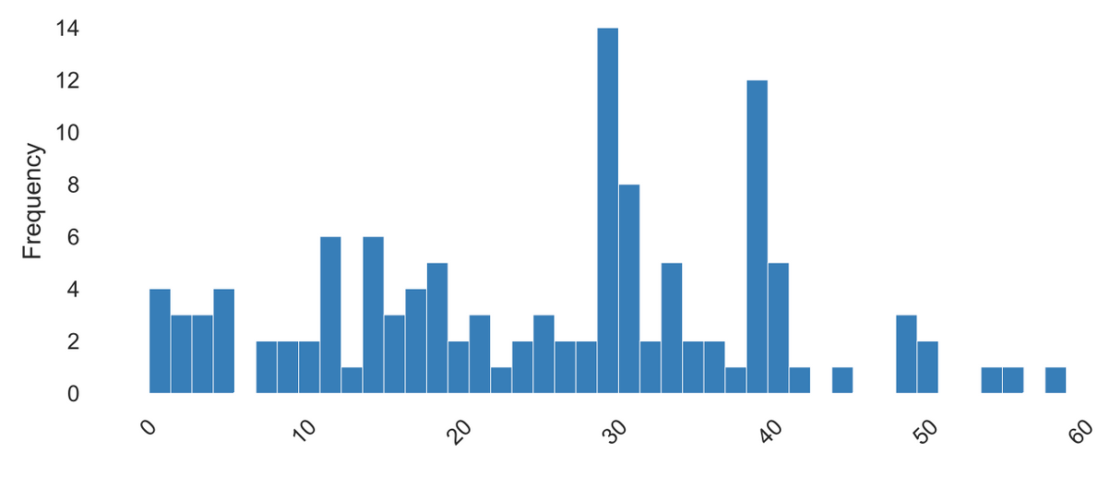
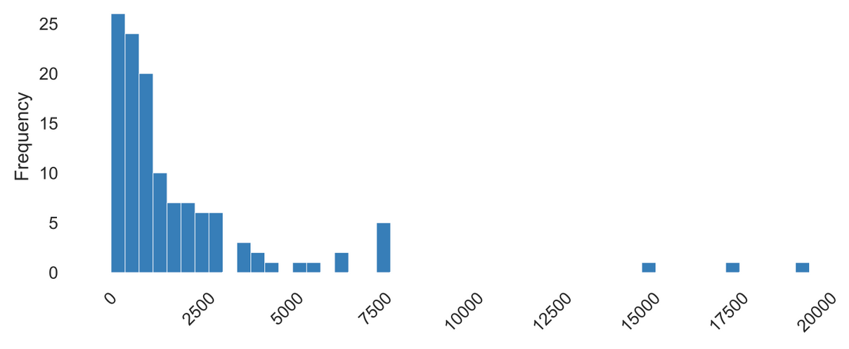
Distribution of Number of Colors
Distribution of Number of Reviews

Slide 8
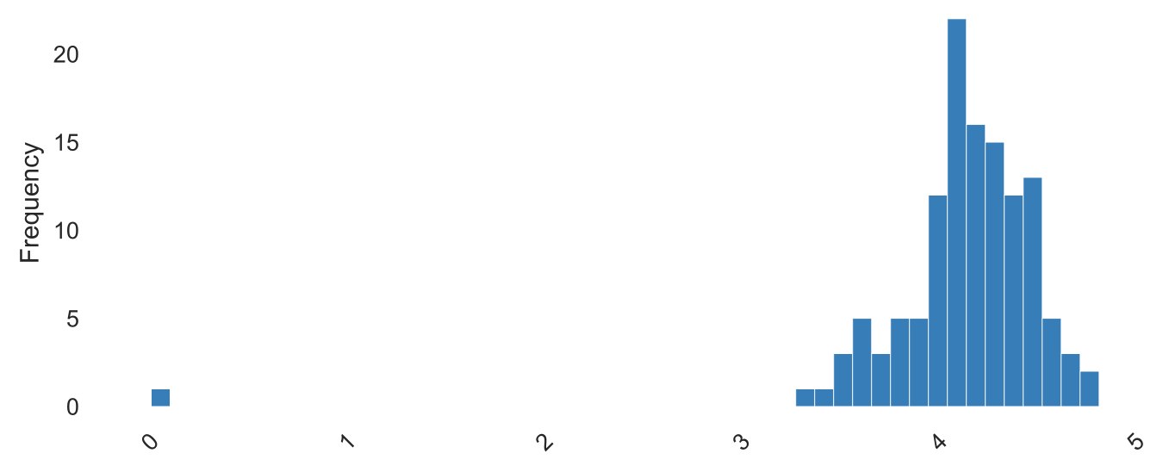
Distribution of Ratings

Slide 9
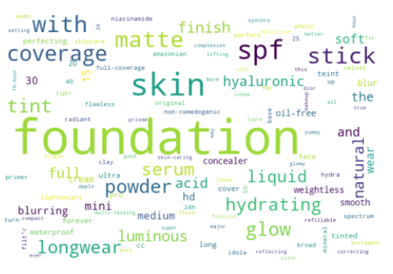
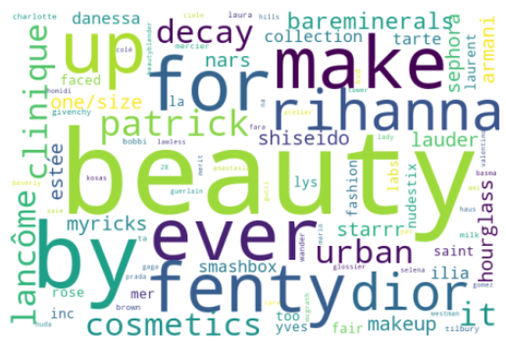
Product Name
Brand Name

Slide 10
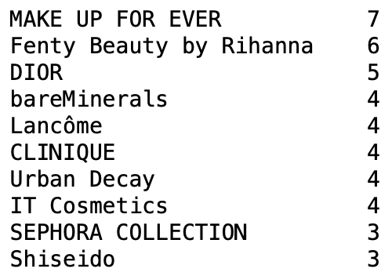
TOP 10 BRANDS WITH MOST PRODUCTS

Slide 11

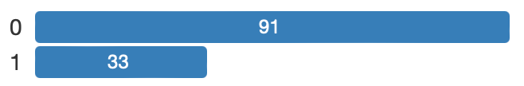
isLimitedEdition
01.
OTHER VARIABLES
isSephoraExclusive
02.
isNatural, isOrganic, & isSponsored
03.

Slide 12
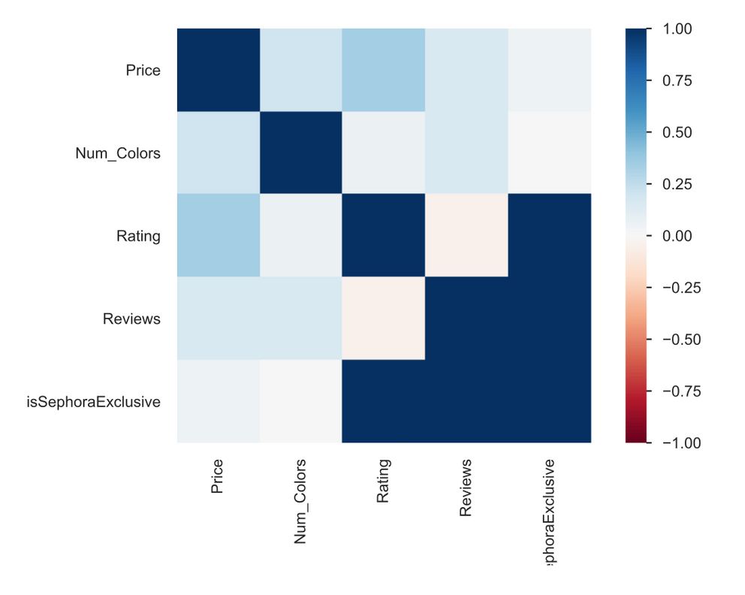
HEATMAP

Slide 13
THANK YOU!

